Slide 1
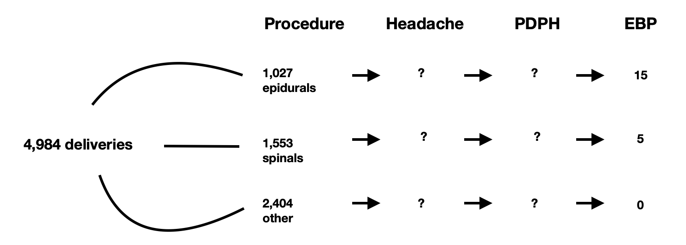
Epidural blood patch demographics and outcomes: a retrospective analysis
Dr J Whiting¹, Dr S Maguire²
1 Anaesthetics Core Trainee, Wythenshawe Hospital, Manchester, UK 2Consultant Anaesthestist, Wythenshawe Hospital, Manchester, UK
Introduction
Results
Post-dural puncture headache (PDPH) is a potential complication of epidural and spinal anaesthesia, caused by leak of cerebrospinal fluid. PDPH can result in significant morbidity for the obstetric patient. Accidental dural puncture occurs in approximately 1.5% of cases (1), and over 50% of these patients develop PDPH (1). Risk of PDPH following neuraxial procedures is therefore widely stated as being between 1 in 100 and 1 in 200. Management includes bed rest, caffeine, hydration and epidural blood patch (EBP). EBP success rates are quoted as approximately 70% (2). We aimed to obtain data regarding the incidence and success of EBPs in our UK obstetric unit for 2021 with the goal of using this data to improve patient information and to aid integrating data collection into a new electronic health record.
There were 4984 deliveries at Wythenshawe in 2021 with 1027 epidurals, 1553 spinals and 16 patients requiring EBP (1 required a repeat procedure). Of these deliveries, 1847 (37%) were by Caesarean Section. The proportion of neuraxial procedures needing an EBP was 0.66% (1.2% for epidurals alone and 0.1% for spinal alone). 3 of the 16 patients had both epidural and spinal anaesthesia. 15 of the proceeding procedures (79%) required multiple attempts. The mean time between neuraxial procedure and PDPH onset was 43 hours. The mean time between PDPH onset and EBP was 72 hours. 9 (53%) of EBPs gave complete resolution of symptoms. 12 patients were followed up in anaesthetic clinic between 4 and 6 weeks postnatal. 2 of these patients had persisting symptoms (tinnitus; persisting lower back and limb pain) and referred to specialist clinics. 4 patients were lost to follow-up.
From this audit we have determined what data collection we require for our Trust’s new electronic patient record (Figure 1) in order to identify all postnatal headaches, ensure a standard PDPH protocol, improve patient follow up and future audit quality. There is a need for more granular data to allow all members of the perinatal team to be involved in highlighting postnatal complications of regional anaesthesia. We plan to repeat this when our new system is embedded.
References
Choi PT, Galinski SE, Takeuchi L, Lucas S, Tamayo C, Jadad AR. PDPH is a common complication of neuraxial blockade in parturients: a meta-analysis of obstetrical studies. Can J Anaesth. 2003;50:460–469
Russell R, Laxton C, Lucas DN, Niewiarowski J, Scrutton M, Stocks G. Treatment of obstetric post-dural puncture headache. Part 2: epidural blood patch. Int J Obstet Anesth. 2019 May;38:104-118. doi: 10.1016/j.ijoa.2018.12.005. Epub 2018 Dec 22. PMID: 30711239.
Hassan A, McGlennan C, Christmas T. P.17 Post-dural puncture headache: data from a UK tertiary centre 2018–2021 and the effect of the SARS-CoV-2 pandemic. Int J Obstet Anesth. 2022 May;50:15. doi: 10.1016/j.ijoa.2022.103313. Epub 2022 May 3. PMCID: PMC9759194.
Methods
Figure 1: data required for our new electronic patient record
Approval was obtained from the trust audit department. We reviewed our obstetric anaesthetic database from 1st January - 31st December 2021 looking at demographics as well as mode of delivery, analgesia, age, BMI and follow up. Copies of physical notes were obtained for relevant patients and reviewed retrospectively. Denominator data was obtained from the Maternity Governance office.
Conclusion
Our rate of EBPs following neuraxial blockade in 2021 was higher than in recent existing literature (3). EBPs gave complete resolution in just over half of cases, which is lower than reported success rates elsewhere (2). There were very few cases requiring repeat EBP. The mean time from PDPH onset to EBP was in keeping with current recommendations (2). Further analysis is required in order to determine our PDPH rate.
@medillus
Medical.illustration@mft.nhs.uk Oxford Road Campus Tel: 0161 2764139
Medical.illustrationSouth@mft.nhs.uk Wythenshawe Tel: 0161 291 5832
Template designed by Medical Illustration MFT

